Slide 1
Unit – 1
Machine Learning as Subset of AI

Slide 2
Introduction : What is Machine Learning?
A machine learning algorithm then takes these examples and produces a program that does the job.
The program produced by the learning algorithm may look very different from a typical written program.
If we do it right, the program works for new cases as well as the ones we trained it on.
Examples
Testing
Training
Input
Mapping Function
(Model / Program)
Correct output

Slide 3

Introduction : What is Machine Learning?
Identifying Buying patterns
It is tough for humans to learn and predict the customer’s buying patterns, though the process is random
Machines perform better than humans!!!

Slide 4
Few applications of Machine Learning
Analyzing credit applications based on bank’s past data
Fraud detection
Stock market prediction
In manufacturing for optimization, control and trouble shooting
In medicine, for medical diagnostics
In telecommunications, for network optimization, call patterns.
For information retrieval and analysis on www or social media

Slide 5
Machine learning
Machine learning is a part of artificial intelligence rather than being a simple database problem.
It needs to learn from constantly changing environment.
Definition: A computer program is said to “learn” from experience “E” with respect to some class of tasks “T” and performance measure “P”, if its performance at tasks in T, as measured by P, improves with experience E.
Source: https://www.guru.com/d/freelancers/q/machine-learning/

Slide 6
Success cases of machine learning
Spam mail detection
Segmentation of customer behavior for targeted advertising
Forecasts of weather behavior and long term climate changes
Reduction of fraudulent credit card transactions
Actuarial estimates of financial damage of storms and natural disasters.
Prediction of popular election outcomes
Development of algorithms for auto-piloting drones and self driving cars.
Optimization of energy use in homes and office buildings.
Projection of areas where criminal activity is most likely.
Discovery of genetic sequences linked to diseases.

Slide 7
Limitations of Machine Learning
Machine learning is in no way a substitute to a human brain yet.
It has no freedom to extrapolate outside of the strict parameters it learned and does not have common sense.
Unless trained with enormous past experience to build a model upon, computers can show limited common sense inferences about logical next steps.
E.g. search for a text book.
Even after you have bought the book, the banner advertisements would keeping popping up on your browser.
Even after you have bought a house, it would keep on showing advertisements of available options. On the contrary, it should now show you options for interior designing, furniture etc.
There has been limited success in language translation, recognizing speech and handwriting.

Slide 8
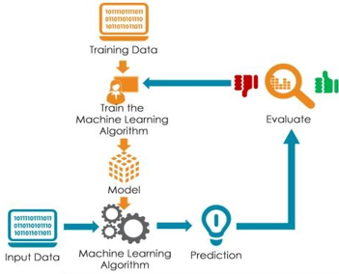
How do machines learn?

Slide 9
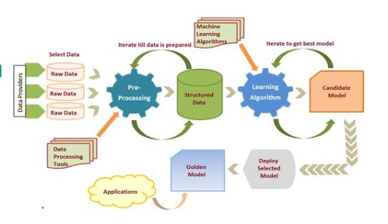
How do machines learn?

Slide 10
How do machines learn?
Data storage
All learning must begin with data.
Humans and computers alike utilize data storage as a foundation for more advanced reasoning.
Computers have capabilities of short and long term memory similar to human brain to store data in hard drives, flash memories, RAM etc.

Slide 11
Abstraction and knowledge representation
How do machines learn?
Assigning meaning to stored data occurs during the abstraction process, in which raw data gets an abstract meaning.
During a machine’s process of knowledge representation, the computer summarizes the raw data stored using a model, an explicit description of the patterns within the data.
The model representation takes on a life beyond the raw data. It represents an idea greater than the sum of its parts.
There are different types of models, for example:
Mathematical equations.
Relational diagrams such as trees and graphs.
Logical if/else rules.
Groupings of data known as clusters.

Slide 12
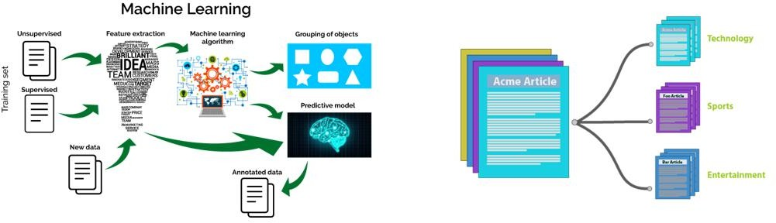
General ML architecture
As the predictive models are well instructed regarding what they need to learn and how they are intended to learn it, the process of training a predictive model is known as supervised learning.
The often used supervised machine learning task of predicting which category an example belongs to is known as classification.
In the case of classification, the target feature to be predicted is a categorical feature known as the class, and is divided into categories called levels.
Source: https://www.xenonstack.com/blog/log-analytics-deep-machine-learning/

Slide 13
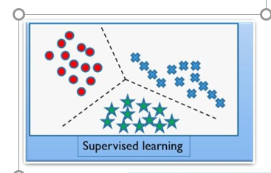
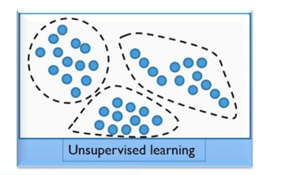
Machine learning methods

Slide 14
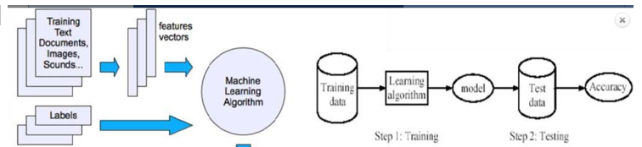
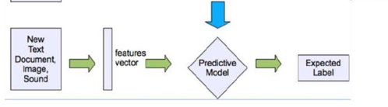
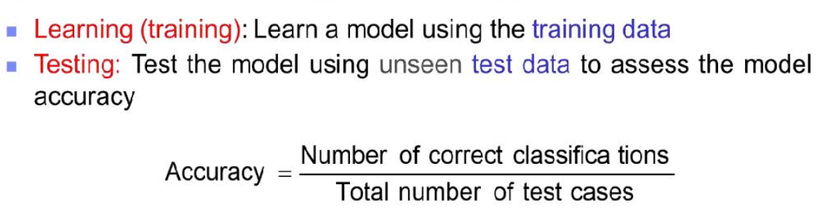
Supervised Learning

Slide 15
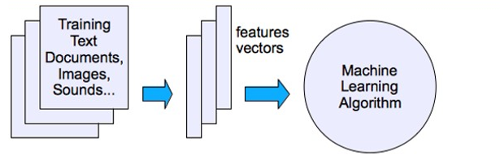
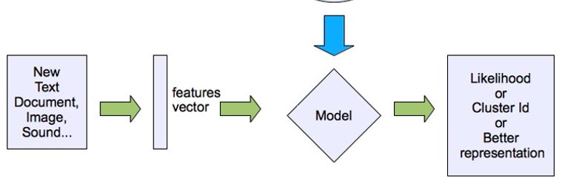
Unsupervised learning

Slide 16
Unsupervised learning
IBM ICE (Innovation Centre for Education)
Supervised learning, teaches a mapping from the input to an output where the correct values are provided, by a supervisor.
In the cases of unsupervised learning, we are provided with only the data, without labels.
The goal is to find the regularities in the input.
The input space follows certain patterns, our goal is to build a model to identify these patterns.
Source: https://www.edureka.co/blog/machine-learning-tutorial/

Slide 17
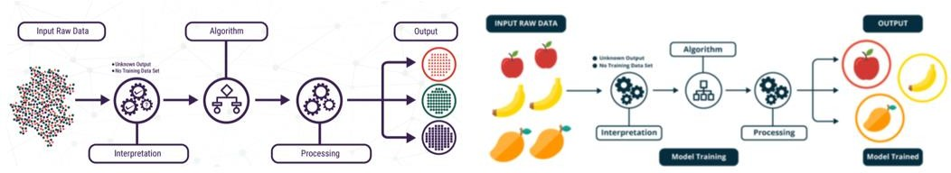
Unsupervised learning
IBM ICE (Innovation Centre for Education)
Supervised learning, teaches a mapping from the input to an output where the correct values are provided, by a supervisor.
In the cases of unsupervised learning, we are provided with only the data, without labels.
The goal is to find the regularities in the input.
The input space follows certain patterns, our goal is to build a model to identify these patterns.
Source: https://www.edureka.co/blog/machine-learning-tutorial/

Slide 18
Unsupervised learning
Supervised learning, teaches a mapping from the input to an output where the correct values are provided, by a supervisor.
In the cases of unsupervised learning, we are provided with only the data, without labels.
The goal is to find the regularities in the input.
The input space follows certain patterns, our goal is to build a model to identify these patterns.
Source: https://www.edureka.co/blog/machine-learning-tutorial/

Slide 19
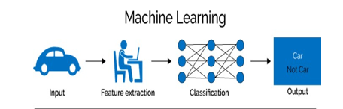
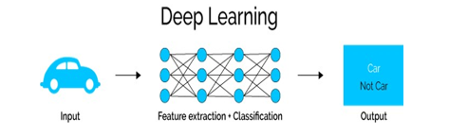
Deep learning algorithms
Deep learning methods are a modern extension to artificial neural networks with better efficiency.
Deep learning methods are concerned with building much larger and more complex neural networks
Many methods are concerned with semi-supervised learning problems where large datasets contain very little labeled data.

Slide 20
Types of Deep Learning
Deep learning encompasses various architectures, each suited to different types of tasks:
Convolutional Neural Networks (CNNs): Primarily used for image processing tasks, CNNs are designed to automatically and adaptively learn spatial hierarchies of features through convolutional layers.
Recurrent Neural Networks (RNNs): Ideal for sequential data, such as time series or natural language, RNNs have loops that allow information to persist, making them effective for tasks like speech recognition and language modeling.
Long Short-Term Memory Networks (LSTMs): A type of RNN that addresses the vanishing gradient problem, LSTMs are used for complex sequences, including text and speech.
Generative Adversarial Networks (GANs): These consist of two neural networks (generator and discriminator) that compete against each other, leading to the creation of high-quality synthetic data, such as images.
Transformers: A more recent architecture designed for handling long-range dependencies in data, transformers are the backbone of models like GPT and BERT, used extensively in natural language processing.

Slide 21
Difference between ML and DL
Machine Learning | Deep Learning
Machine Learning is a superset of Deep Learning | Deep Learning is a subset of Machine Learning
The data represented in Machine Learning is quite different compared to Deep Learning as it uses structured data | The data representation used in Deep Learning is quite different as it uses neural networks(ANN).
Machine Learning is an evolution of AI. | Deep Learning is an evolution of Machine Learning. Basically, it is how deep is the machine learning.
Machine learning consists of thousands of data points. | Big Data: Millions of data points.
Outputs: Numerical Value, like classification of the score. | Anything from numerical values to free-form elements, such as free text and sound.
Uses various types of automated algorithms that turn to model functions and predict future action from data. | Uses a neural network that passes data through processing layers to, interpret data features and relations.
Algorithms are detected by data analysts to examine specific variables in data sets. | Algorithms are largely self-depicted on data analysis once they’re put into production.
Machine Learning is highly used to stay in the competition and learn new things. | Deep Learning solves complex machine-learning issues.
Training can be performed using the CPU (Central Processing Unit). | A dedicated GPU (Graphics Processing Unit) is required for training.
More human intervention is involved in getting results. | Although more difficult to set up, deep learning requires less intervention once it is running.
Machine learning systems can be swiftly set up and run, but their effectiveness may be constrained. | Although they require additional setup time, deep learning algorithms can produce results immediately (although the quality is likely to improve over time as more data becomes available).
Its model takes less time in training due to its small size. | A huge amount of time is taken because of very big data points.

Slide 22
Contd…
Humans explicitly do feature engineering. | Feature engineering is not needed because important features are automatically detected by neural networks.
Machine learning applications are simpler compared to deep learning and can be executed on standard computers. | Deep learning systems utilize much more powerful hardware and resources.
The results of an ML model are easy to explain. | The results of deep learning are difficult to explain.
Machine learning models can be used to solve straightforward or a little bit challenging issues. | Deep learning models are appropriate for resolving challenging issues.
Banks, doctor’s offices, and mailboxes all employ machine learning already. | Deep learning technology enables increasingly sophisticated and autonomous algorithms, such as self-driving automobiles or surgical robots.
Machine learning involves training algorithms to identify patterns and relationships in data. | Deep learning, on the other hand, uses complex neural networks with multiple layers to analyze more intricate patterns and relationships.
Machine learning algorithms can range from simple linear models to more complex models such as decision trees and random forests. | Deep learning algorithms, on the other hand, are based on artificial neural networks that consist of multiple layers and nodes.
Machine learning algorithms typically require less data than deep learning algorithms, but the quality of the data is more important. | Deep learning algorithms, on the other hand, require large amounts of data to train the neural networks but can learn and improve on their own as they process more data.
Machine learning is used for a wide range of applications, such as regression, classification, and clustering. | Deep learning, on the other hand, is mostly used for complex tasks such as image and speech recognition, natural language processing, and autonomous systems.
Machine learning algorithms for complex tasks, but they can also be more difficult to train and may require more computational resources. | Deep learning algorithms are more accurate than machine learning algorithms.

